Slide 1

DEPARTMENT OF COMPUTER SCIENCE AND ENGINEERING
DRIEMS POLYTECHNIC, TANGI, CUTTACK-754022
“Breast Cancer Prediction Using
Machine Learning”
By
ABDUL WAHED F20026007001
ANIKET MOHANTY F20026007003
BISWAJIT DAS F20026007010
PRAVAT JYOTI MOHANTY F20026007031
SUSANTA KUMAR BEHERA L21026007005
GUIDED BY:- Presented By:-
Soumya Snigdha Mohapatra Abdul Wahed
Asst. Professor 6th Semester
Dept. of Computer Science & Engg. Regd. No: F20026007001

Slide 2
Content:-
Introduction
Objective
Literature Review
Data collection
Methodology
Result & discussion
Conclusion & future scope
Reference

Slide 3
Introduction
What is Breast Cancer?
After lung cancer, the most dangerous cancer is breast cancer, In India, statistics show that nearly 1,60,000 women were reported with breast cancer out of which more than 85,000 were the cases of death.
How is it diagnosed usually?
A mammogram is an X-ray picture of the breast. Doctors use a mammogram to look for early signs of breast cancer. Regular mammograms are the best tests doctors have to find breast cancer early, sometimes up to three years before it can be felt.

Slide 4
Demerits of using manual techniques like FNA(Fine Needle Aspiration).
One disadvantage of FNA is that the procedure only removes very small samples of tissue or cells from the breast.
If the tissue is solid or if a sample of cloudy, suspicious-looking fluid is obtained, the small number of cells removed makes it difficult to predict if the cancer is benign or malignant.

Slide 5
Merits of predicting through machine learning.
Screening often allows for the detection of cancers at an early stage of development. Treatment is then possible without chemotherapy.
The vast majority of women (nearly 98 %) will not have breast cancer if their mammograms and additional examinations do not reveal cancers.
Of 1,000 women who have a mammogram every 2 years for 20 years, 7 deaths are prevented.

Slide 6
Objectives.
Early warning: The main goal of breast cancer prediction is to provide early warnings of being affected by breast cancer. Early warnings can help reduce the mortality rate through breast cancer.
Resource allocation: Another goal of Breast cancer prediction is to allocate resources efficiently to mitigate the risks associated with breast cancer.

Slide 7
Data Collection.
The dataset has been collected from kaggle repository that is set is for Breast cancer prediction of Wisconsin, USA. It consists of 569 rows and 33 attributes.
The attributes are Breast radius,texture, perimeter, area,smoothness, compactness, concavity, concave points, symmetry, and fractal dimension.
Among the different variable “Diagnosis” has been considered as the output variable and remaining 32 are the input variable .The reference of the data set has been provided in the below link.

Slide 8
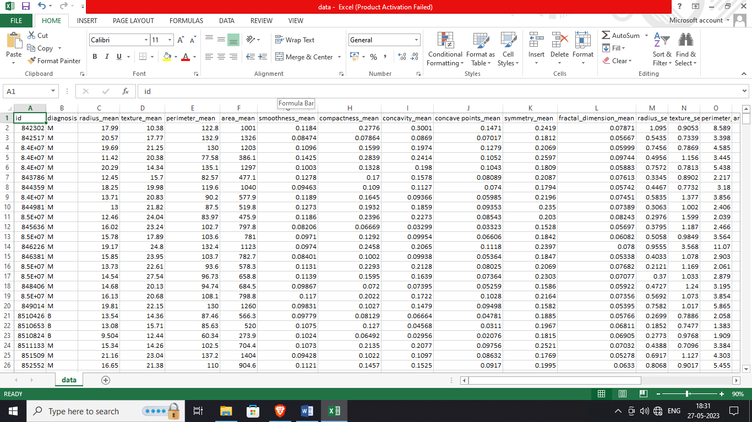
Link:-https://www.kaggle.com/datasets/uciml/breast-cancer-wisconsin-data
Breast Cancer Dataset

Slide 9
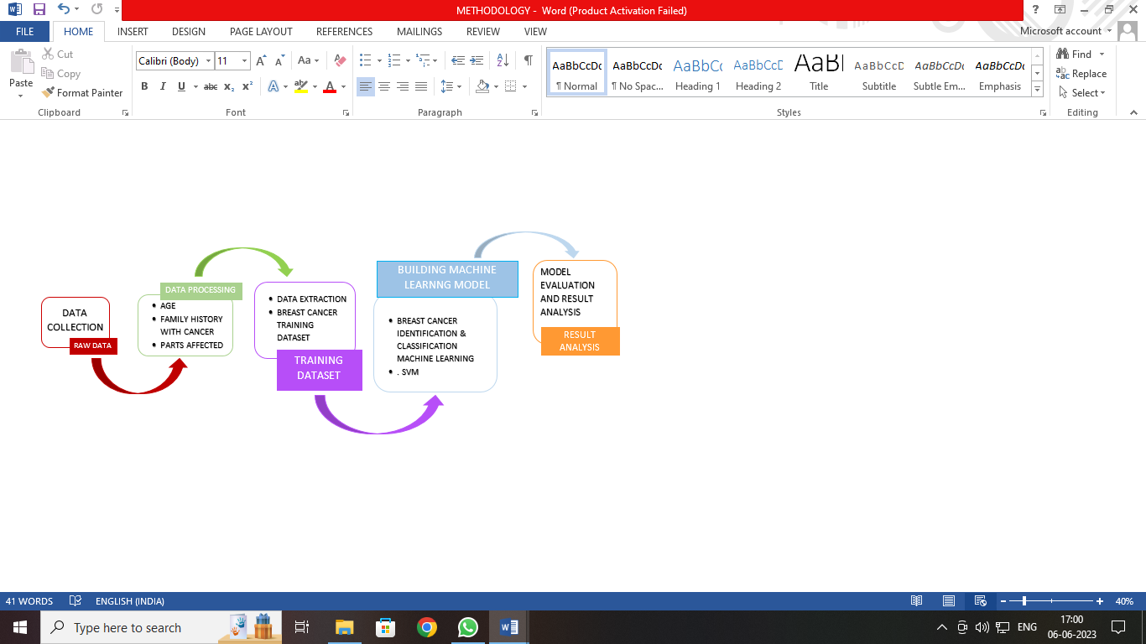
Methodology.
Data Collection
      Using pre-collected data, by way of data sets from Kaggle, UCI, etc., still fits into this step.
      Data Preparation
      Clean that which may require it (remove duplicates, correct errors, deal with missing values, normalization, data type, conversions, etc.)
      Randomize data, which erases the effects of the particular order in which we collected and/or other wise prepared our data

Slide 10
Train the Model
Different algorithms are for different tasks, choose the right one.
The goal of training is to answer a question or make a prediction correctly as often as possible
Evaluate the Model
      Uses some metric or combination of metrics to "measure“ objective performance of model
      Make Predictions
      Using further (test set) data which have, until this point, been withheld from the model (and for which class labels are known), are used to test the model; a better approximation of how the model will perform in the real world.

Slide 11
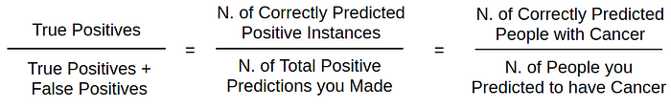
SVM
SVM is a powerful supervised algorithm that works best on smaller datasets but on complex ones. Support Vector Machine, abbreviated as SVM can be used for both regression and classification tasks, but generally, they work best in classification problems.
As the severity of different kinds of mistakes varies across use cases, the metrics such as Precision, Recall, F1-score and Support can be used to balance the classifier estimates as preferred.
Precision
Precision is a measure of how many of the positive predictions made are correct (true positives). The formula for it is:

Slide 12
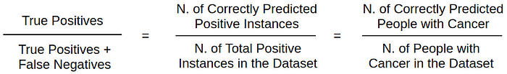

Recall
Recall is a measure of how many of the positive cases the classifier correctly predicted, over all the positive cases in the data. The formula is:
F1-Score
F1-Score is a measure combining both precision and recall. It is described as the harmonic mean of the two. Harmonic mean is just another way to calculate an “average” of values, generally described as more suitable for ratios (such as precision and recall) than the traditional arithmetic mean. The formula used for F1-score in this case is:
The idea is to provide a single metric that weights the two ratios (precision and recall) in a balanced way, requiring both to have a higher value for the F1-score value to rise.

Slide 13
Result
Confusion Matrix
In the context of breast cancer prediction, the confusion matrix can be constructed as follows:
True Positive (TP): This represents the number of breast cancer instances that were correctly predicted as malignant by the model.
True Negative (TN): This represents the number of non-breast cancer instances that were correctly predicted as benign by the model.
False Positive (FP): This represents the number of non-breast cancer instances that were incorrectly predicted as malignant by the model (also known as a Type I error).
False Negative (FN): This represents the number of breast cancer instances that were incorrectly predicted as benign by the model (also known as a Type II error).
Confusion Matrix for Logistic Regression:
 | PREDICTED MALIGNANT | PREDICTED BENIGN
ACTUAL MALIGNANT | TRUE POSITIVE (TP) | FALSE NEGATIVE (FN)
ACTUAL BENIGN | FALSE POSITIVE (FP) | TRUE NEGATIVE (TN)

Slide 14
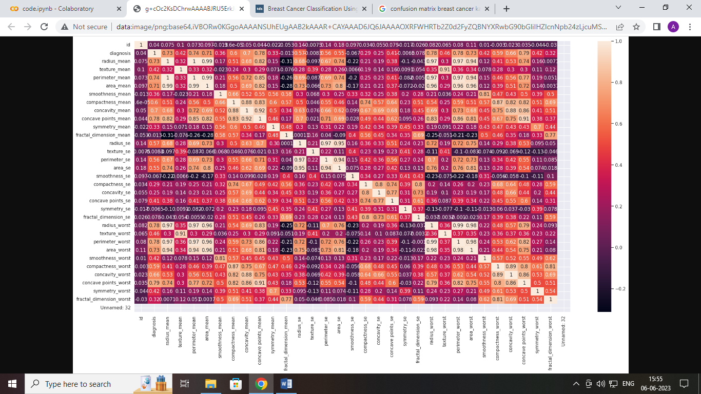

Slide 15
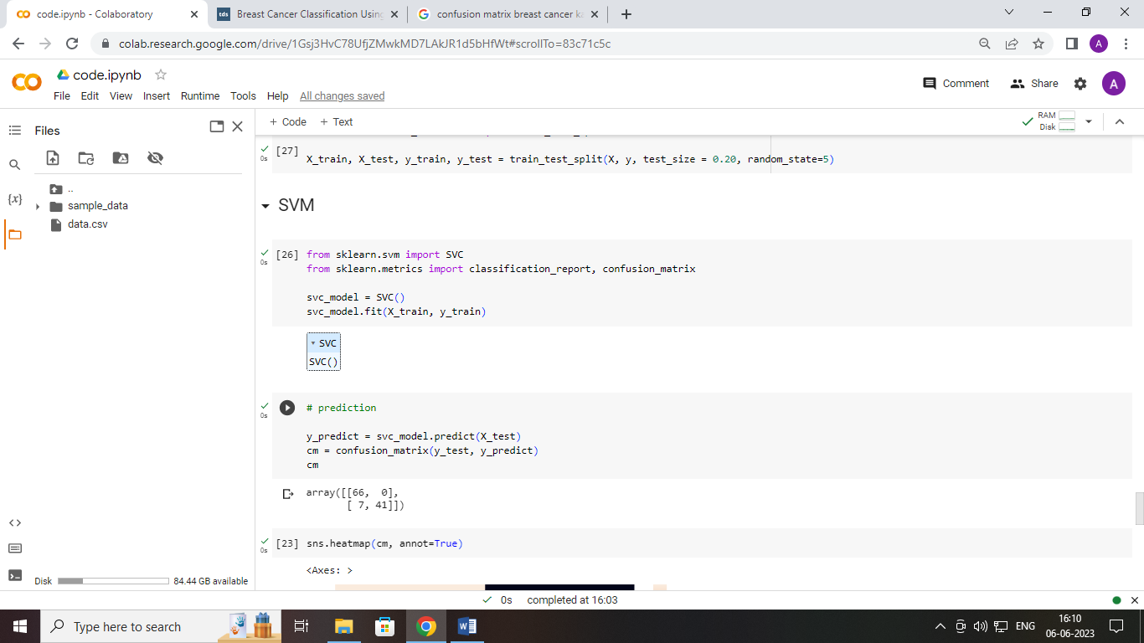
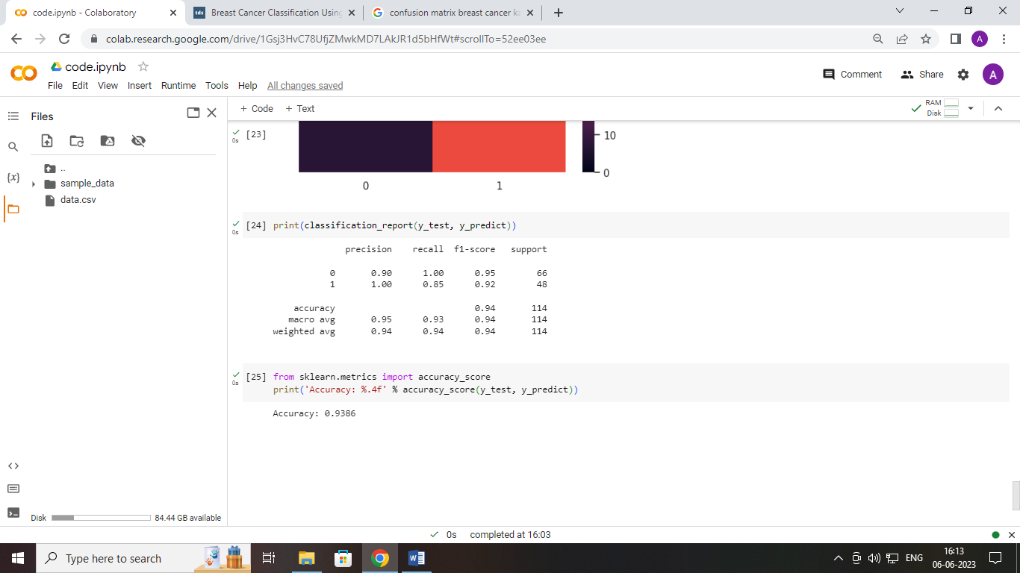
Output & Result

Slide 16
Conclusion & Future Scope
The primary objective of the examination is to increase the precision of the breast cancer conclusion by further developing breast malignant growth expectations.
. In our research, we used SVM (Support Vector Machine) algorithms with the highest F1-scores, with 95 percent.By using Google Colab, the total runtime of each algorithm was approximately 2-3 minutes.
This will increase dependability and improve the exhibition of the framework. By just contributing MRI information, the ML framework can assist the overall population in finding out about the chance of cancer in grown-up patients. Hopefully, it will help people get cancer treatment early and work on their lives.

Slide 17
References
Ali, E. E. E., & Feng, W. Z. (2016). Breast cancer classification using support vector machine and neural network. International Journal of Science and Research, 5(3), 1-6.
Amit Bhola, Arvind Kumar Tiwari, December 2015, “Machine Learning Based Approaches for Cancer Classification using Gene Expression Data.”, MachineLearning and Application: An Intl. J. (MLAIJ), Vol 2, No.3/4
Asri, H., Mousannif, H., Al Moatassime, H., & Noel, T. (2016). Using machine learning algorithms for breast cancer risk prediction and diagnosis. Procedia Computer Science, 83, 1064-1069.
Azar, A. T., & El-Metwally, S. M. (2013). Decision tree classifiers for automated medical diagnosis. Neural Computing and
Applications, 23(7), 2387-2403.
Bazazeh, D., &Shubair, R. (2016, December). Comparative study of machine learning algorithms for breast cancer detection and diagnosis. In 2016 5th international conference on electronic devices, systems and applications (ICEDSA) (pp. 1-4). IEEE.
BharathRangarajan, TanujaShet, TabassumWadasadawala, Nita S. Nair, R. MadhuSairam, Sachin S. Hingmire and JyotiBajpai. (2016 July-September). “Breast cancer: An overview of published Indian data”.
https://www.ncbi.nlm.nih.gov/pmc/articles/PMC4991144/
Chao, C. M., Yu, Y. W., Cheng, B. W., &Kuo, Y. L. (2014). Construction the model on the breast cancer survival analysis use support vector machine, logistic regression and decision tree. Journal of medical systems, 38(10), 1-7.

